Slide 1
A model to discover rare patterns using ML techniques
DBSE - TeamProject-2020
Supervisor - Sadeq Darrab
Team - 11
[Madhu,Deeksha,Seles, Surabhi, Stanley, Priyam]
OVGU

Slide 2
Agenda
Problem-Recap
Literature Survey So far
Comparisons
Baseline Papers

Slide 3
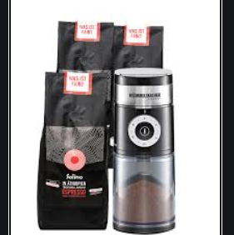

Rare Patterns & Challenges
Rare patterns appears in less percentage of data
Hard to generalise
Older algorithms miss rare patterns because these rules have less than min support
If we lower the minsupport, number of rules generated explodes
Fig 4[1]
Notes:
Cyber attacks, comets, rare patterns are important to discover and are beneficial

Slide 4
Why it's still an open problem
->No single method is guaranteed to work in all situations!
->In case of online continuous streams of data its inefficient to apply existing algorithms.
-> Noise or rare? - Rare Rules generated are really meaningful or just random patterns?
-> Scalability and performance - In both static and streaming data

Slide 5
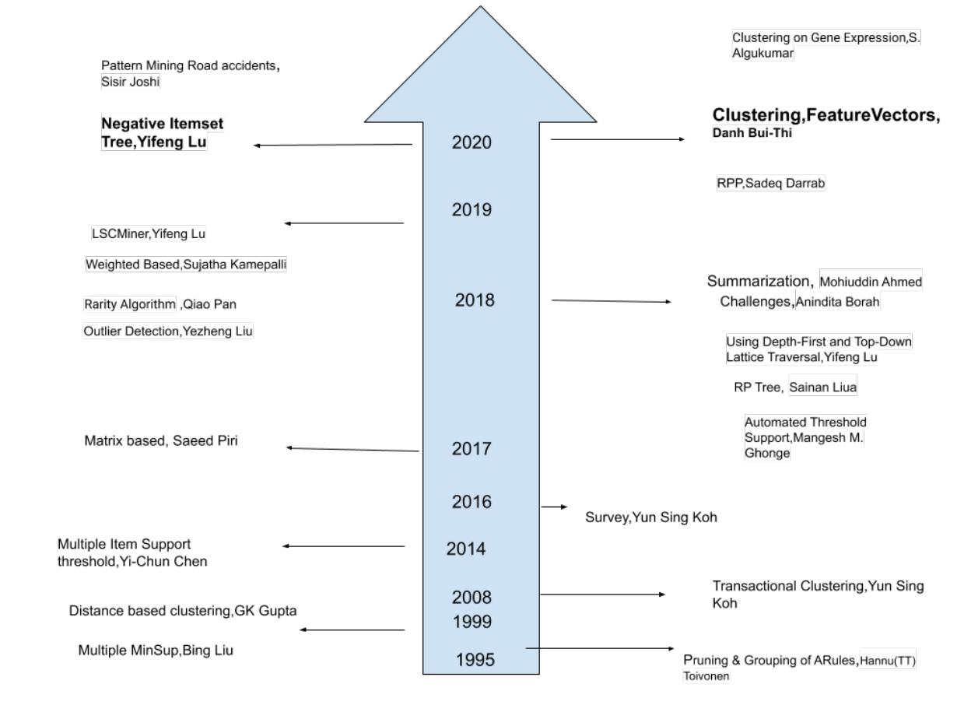
Literature So far..

Slide 6
Comparisons[4]
Variable Support Threshold
Compared to other approaches generate large number of rules, well with general exploratory mining
Tree-Based Approach
More efficient tactic of generating rare rules as the minsup threshold has to be set low
Consequent Constraint-Based Approach
Required prior knowledge, generates specific rules
Without Support Threshold
More actionable rules compared to more generalized

Slide 7
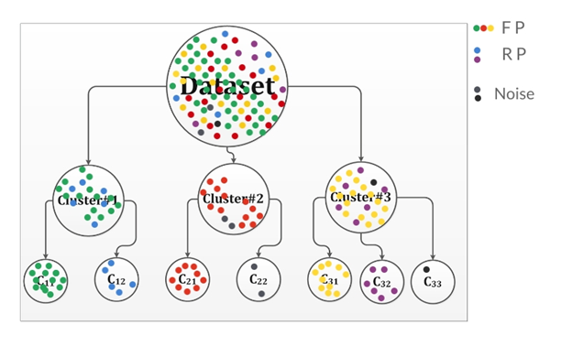
Infrequent pattern mining in smart healthcare environment using data summarization
The goal of summarization is to provide an overview of the data that helps an analyst gain the gist of it and act accordingly[6].
The problem: Modern data summarization techniques does not capture infrequent patterns in the data because the proportion of these patterns are very low in the parent data compared to the predominantly frequent ones.
Proposed Approach: The algorithm SIPPS proposed in the paper has suggested recursive clustering for data summarization.
Fig 5: Recursive Clustering

Slide 8
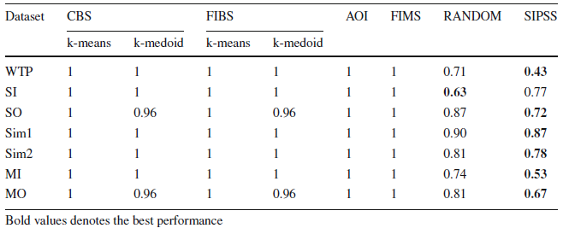
Infrequent pattern mining in smart healthcare environment using data summarization
The idea is that selecting data samples from the finely grained recursive clusters might be more informative that selecting from the unevenly distribute parent clusters, hence infrequent patterns which are small can be found.
We can adapt this model for our task by using a stopping criteria, where we stop the clustering if a threshold is reached depending on the size of our dataset or till 2 clusters are found where 1 of them cluster has only 1 instance as was done in the paper.
For evaluating the model, they benchmarked a set of datasets where they tested 5 data summarization techniques and their approach and it showed that SIPPS performed better based on the metric “Infrequent Pattern Loss”.
Table 3: Comparison of infrequent pattern loss [6]

Slide 9
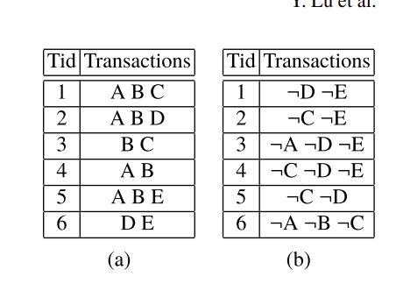
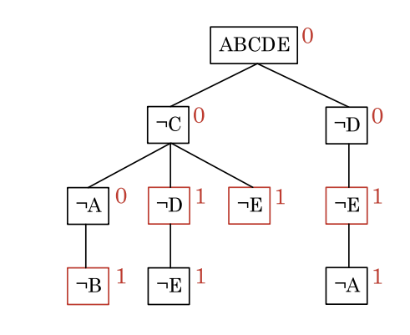
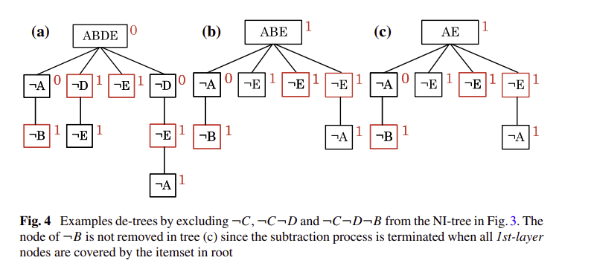
Efficient Infrequent Itemset Mining Using Depth-First and Top-Down Lattice Traversal[7][10]
Using NIIMiner(Negative Infrequent Itemset tree miner) Algorithm
Preliminaries: Given a transaction database D, the (absolute) support of an itemset X is defined as the number of transactions T ∈ D containing X: X.supp = |{T ∈ D|X ⊆ T }|.
An itemset X is infrequent if and only if: 0 < X.supp < minSup. Otherwise, it is frequent (X.supp ≥ minSup) or nonexistent (X.supp = 0).
Transaction Database D→ ~D
2 Support values- Intersection support(D) and Joint support(~D)
Neg-Rep database
How does the algorithm work?
Negative itemset tree(each node n = [¬i, c, l],root node r = [is, c, l)
The mining process extracts infrequent itemsets from the tree by deleting nodes recursively-->de-tree
Removing termination nodes at once so that the generated de tree has a existing pattern.
For rest of the items - divide and conquer
The resulting items - Infrequent list

Slide 10
NIIMiner algorithm is compared to the Rarity algorithm to check the performance
NIIMiner is significantly faster than Rarity under most of the settings
It does not work well with the sparse data and also under large minimum support value and small maximum itemset size settings.
Experimental Evaluation

Slide 11
Efficient Infrequent Pattern Mining Using Negative Itemset Tree
Modified version of the NIIMiner algorithm - top down , breadth first strategy
Pruning the first layer nodes to remove non-existent pattern
Removing the termination node in NIIMiner algorithm is skipped and divide-and-conquer paradigm is performed directly on the initial NI-tree.
Infrequent pattern list is generated.

Slide 12
Evaluation
Experiment conducted on four real datasets obtained from the frequent itemset mining dataset repository (http://fimi.ua.ac.be/data/)
Algorithms compared: LCMFreq and NIIMiner.
Comparison in terms of:
1. Runtime experiments on different absolute minimum support values: NIIMiner is more efficient, since it has access to a huge number of high support patterns.
2. Runtime performance with respect to different dataset sizes: NIIMiner behaviors similar to the bottom- up based approach. The runtime of NIIMiner increased much slower than LCMfreq.
NIIMiner does not work well with extreme sparse dataset.

Slide 13
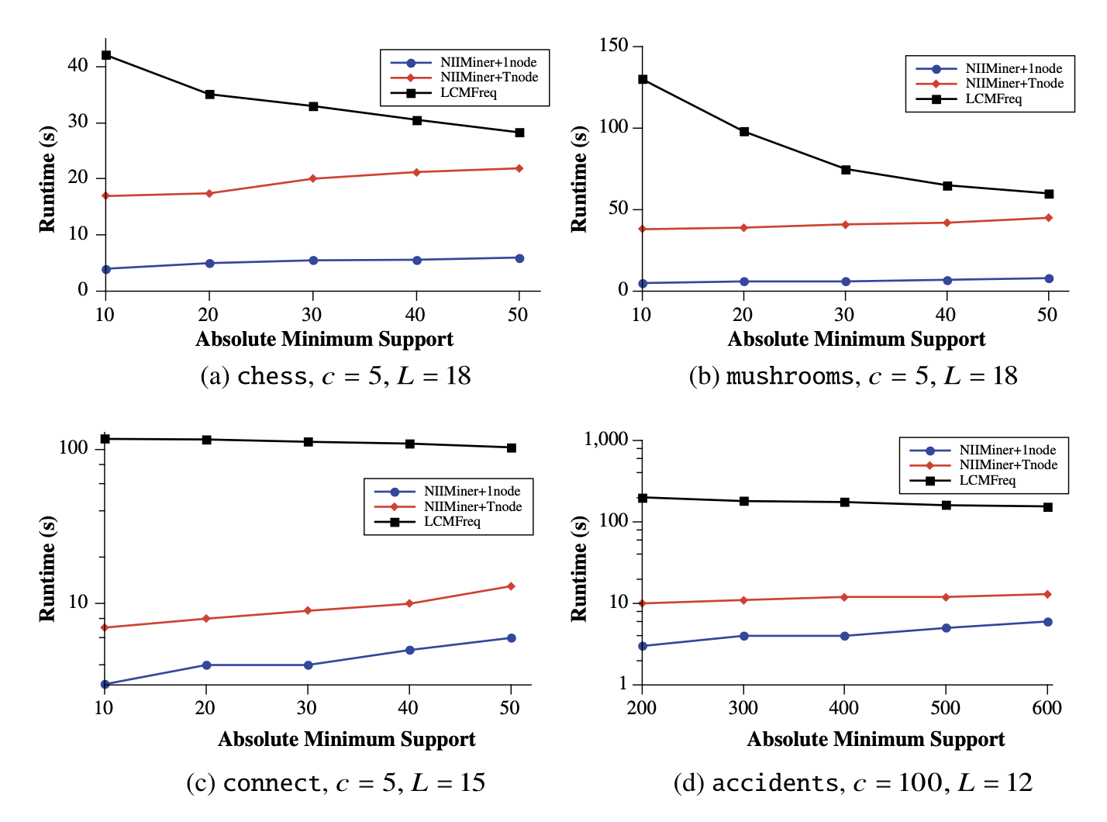
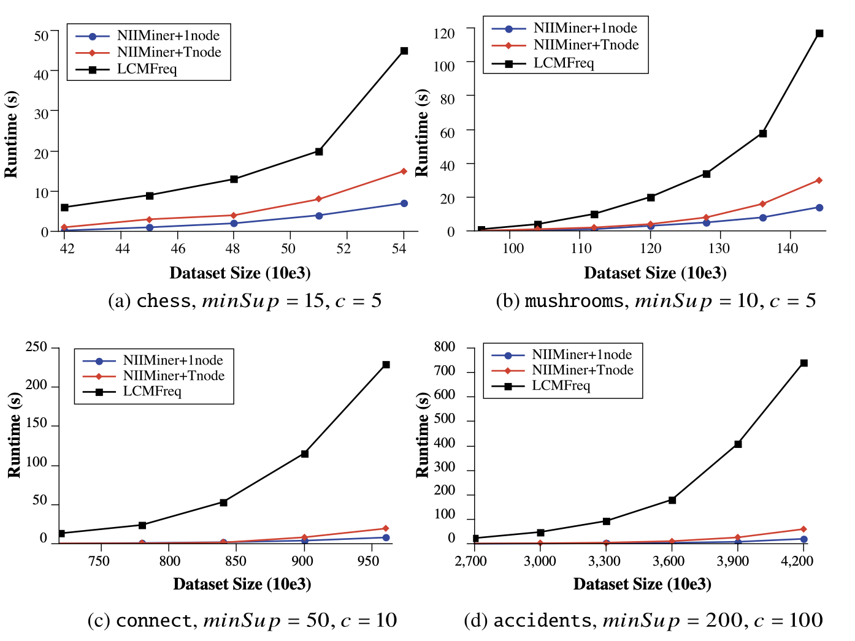
Evaluation continued
Fig 6 [10]: Runtime experiments on different absolute minimum support values
Fig 7 [10]: Runtime experiments on different dataset size

Slide 14
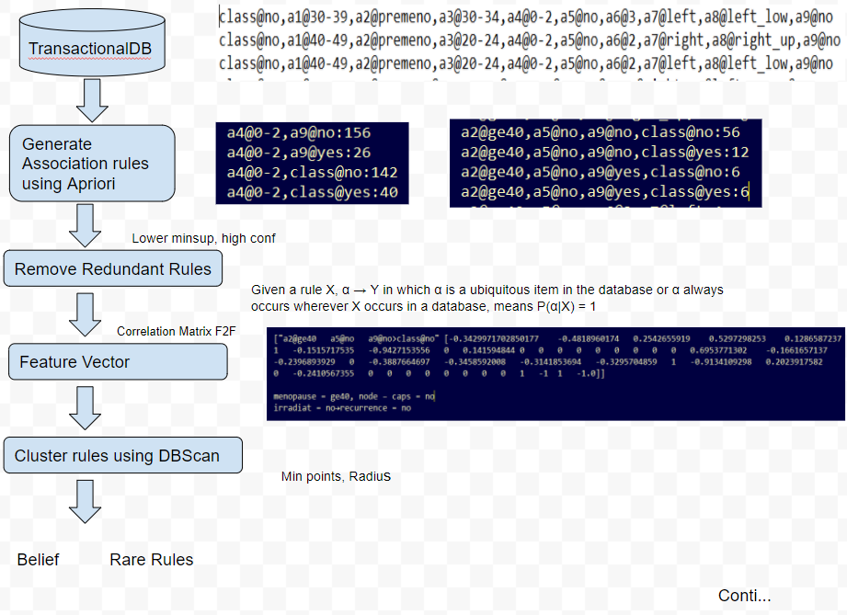
Clustering association rules Step By Step[4]

Slide 15
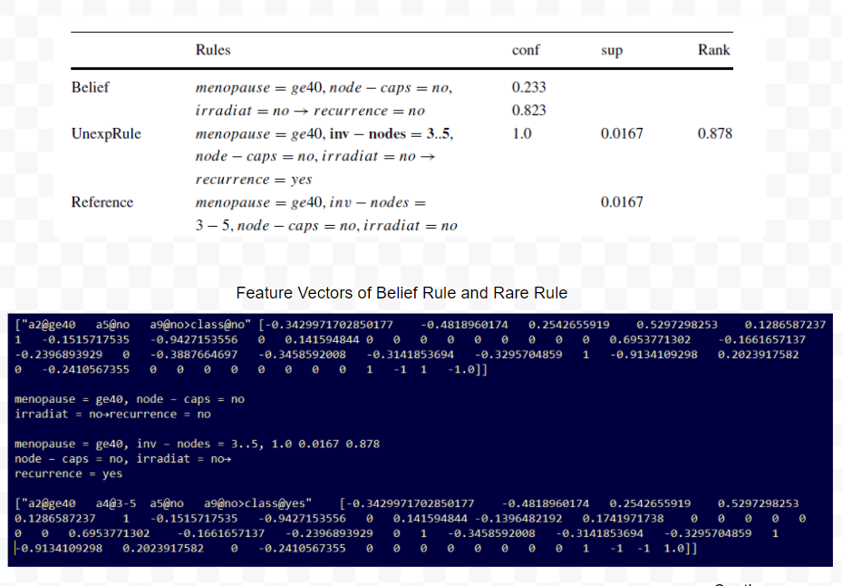
Clustering association rules Step By Step[4]

Slide 16
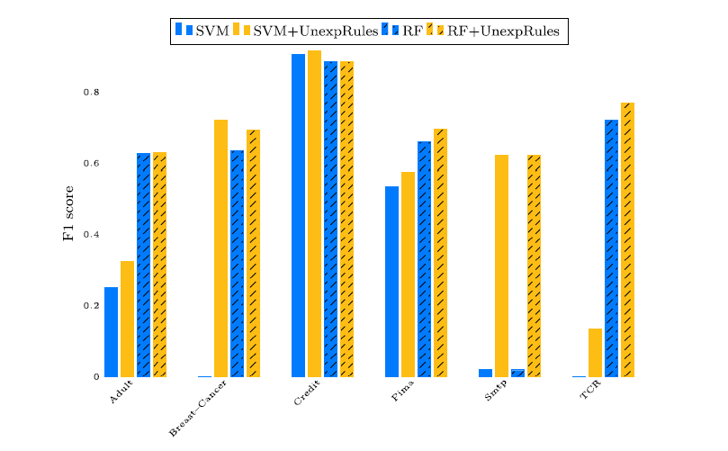
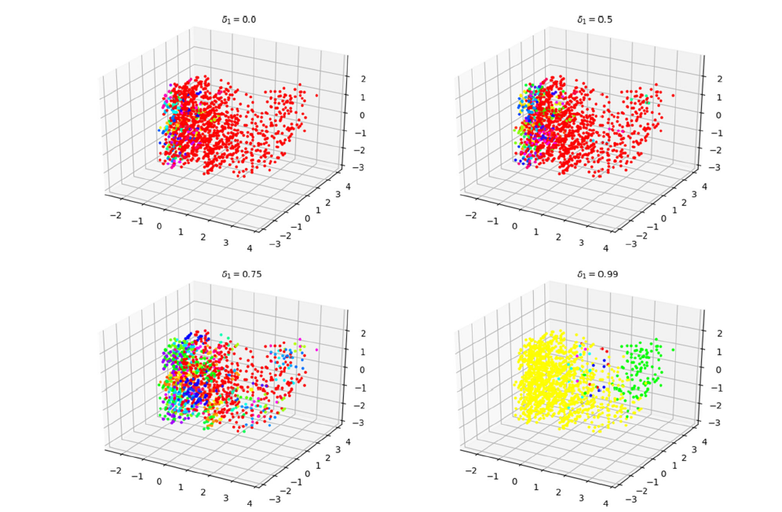
Problems[4]
Problems-
Using Apriori
Correlation matrix for each feature
Tuning hyperparameters of DBSCAN
Evaluation
Conti..

Slide 17
Why Clustering and Negative ItemSet
Can take advantage of well established clustering algorithm
Little or no prior domain knowledge can work
Negative Item set approach can lower the memory constraints

Slide 18
References-
[1] Fig 1 to 4
www.google.com
[2] Fig , 5,6
Yun Sing Koh and Sri Devi Ravana. 2016. Unsupervised rare pattern mining: A survey. ACM Trans. Knowl.
Discov. Data 10, 4, Article 45 (May 2016), 29 pages.
DOI: http://dx.doi.org/10.1145/2898359
[3] Inverse Apriori
Finding Sporadic Rules Using Apriori-Inverse,Yun Sing Koh and Nathan Rountree ,Department of Computer Science, University of Otago, New Zealand {ykoh, rountree}@cs.otago.ac.nz
[4] Clustering association rules
Clustering association rules to build beliefs and discover unexpected patterns,Danh Bui-Thi1 · Pieter Meysman1 · Kris Laukens1,https://doi.org/10.1007/s10489-020-01651-1
[5] RPP RPP Algorithm: A Method for Discovering Interesting Rare Itemsets.Sadeq Darrab(B), David Broneske, and Gunter Saake.University of Magdeburg, Magdeburg, Germany
{sadeq.darrab,david.broneske,gunter.saake}@ovgu.de
[6] Ahmed, Mohiuddin & Barkat Ullah, Abu. (2018). Infrequent pattern mining in smart healthcare environment using data summarization. The Journal of Supercomputing. 74. 10.1007/s11227-018-2376-8.

Slide 19
[7]Efficient Infrequent Itemset Mining Using Depth-First and Top-Down Lattice Traversal by Yifeng Lu(B), Florian Richter, and Thomas Seidl, https://link.springer.com/chapter/10.1007/978-3-319-91452-7_58
[8]Rare Association Rules Mining of Diabetic Complications Based on Improved Rarity Algorithm by Qiao Pan, Lan Xiang, Yanhong Jin School of Computer Science and Technology, Donghua University Shanghai, China, https://ieeexplore.ieee.org/abstract/document/8854639
[9]Mining Rare Patterns by Using Automated Threshold Support Prof. Mangesh Ghonge1 , Miss Neha Rane, https://www.researchgate.net/publication/326490523_Mining_Rare_Patterns_by_Using_Automated_Threshold_Support
[10]Efficient Infrequent Pattern Mining Using Negative Itemset Tree by Yifeng Lu, Florian Richter and Thomas Seidl,
https://www.researchgate.net/publication/338574634_Efficient_Infrequent_Pattern_Mining_Using_Negative_Itemset_Tree
[11]DISTANCE BASED CLUSTERING OF ASSOCIATION RULES GUNJAN K. GUPTA , ALEXANDER STREHL AND JOYDEEP GHOSHDepartment of Electrical and Computer Engineering The University of Texas at Austin,
[12]
[13]
[14]
[15]

